Slide 1

Beer Data Analysis
-Siddhesh Chavan

Slide 2
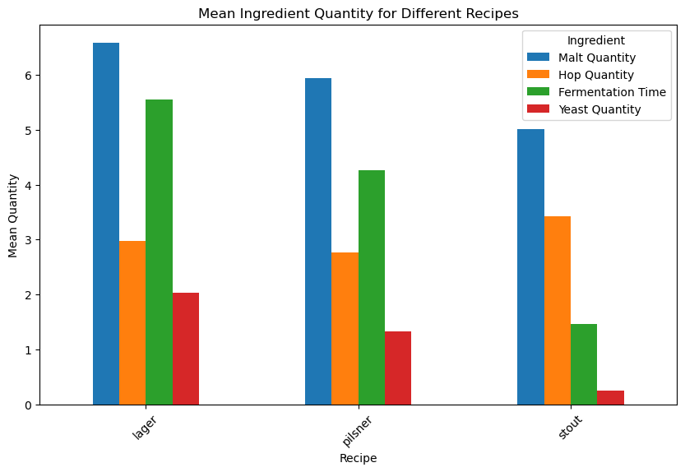
Exploratory Data Analysis
Lager requires a significantly higher amount of malt, yeast, and fermentation time compared to other beer types such as pilsner and stout.
Among the three, lager demands the longest fermentation time, followed by pilsner and then stout.
Stout utilizes the least amount of yeast, with pilsner utilizing approximately four times more yeast than stout, and lager utilizing approximately eight times more yeast than stout.
Hop quantity remains relatively equal across lager, pilsner, and stout, indicating a consistent use of hops regardless of beer type.

Slide 3
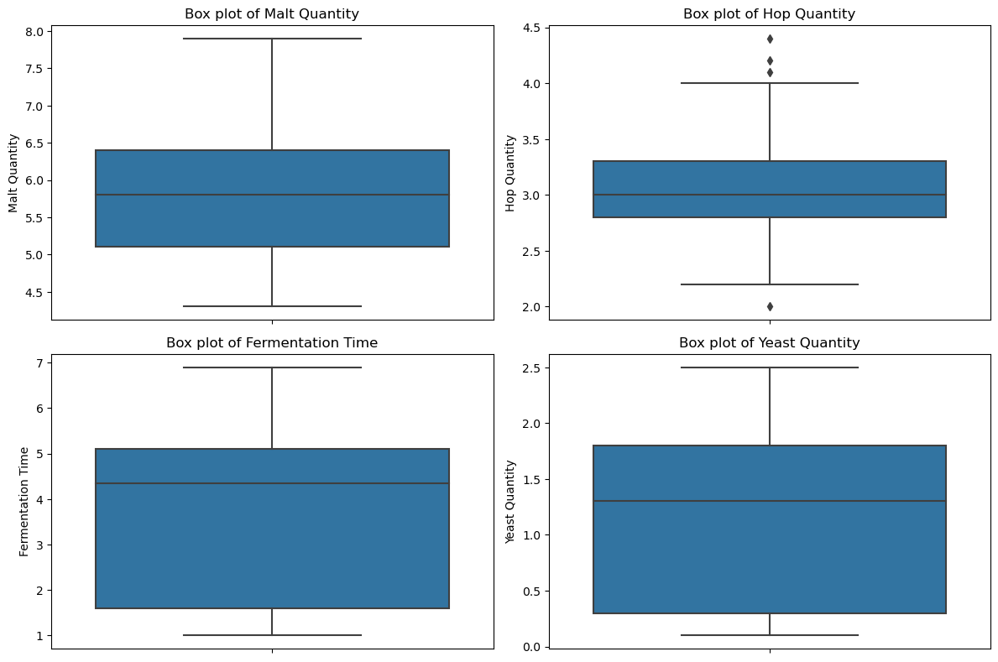
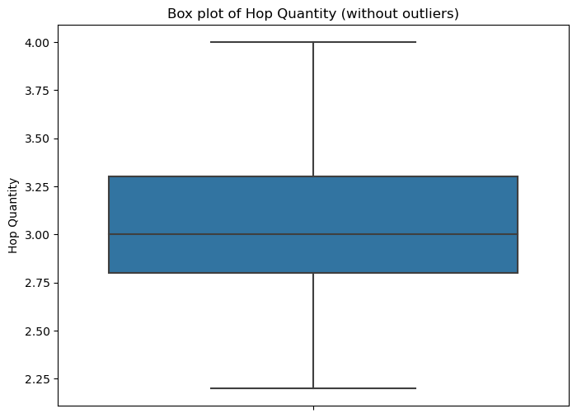
Data Cleaning
The Data Clearly shown we have some outliers in Hop quantity which should be removed. IQR Method is used to remove outliers.
Data after cleaning

Slide 4
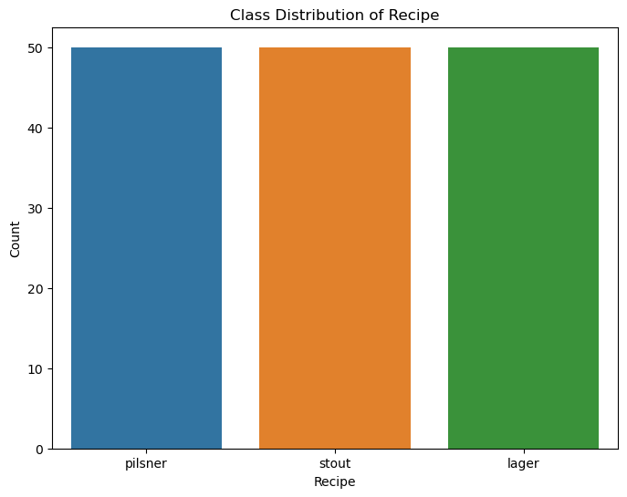
Class Distribution
Ensured balanced representation across recipe classes to mitigate bias, eliminating the necessity for stratified sampling.

Slide 5
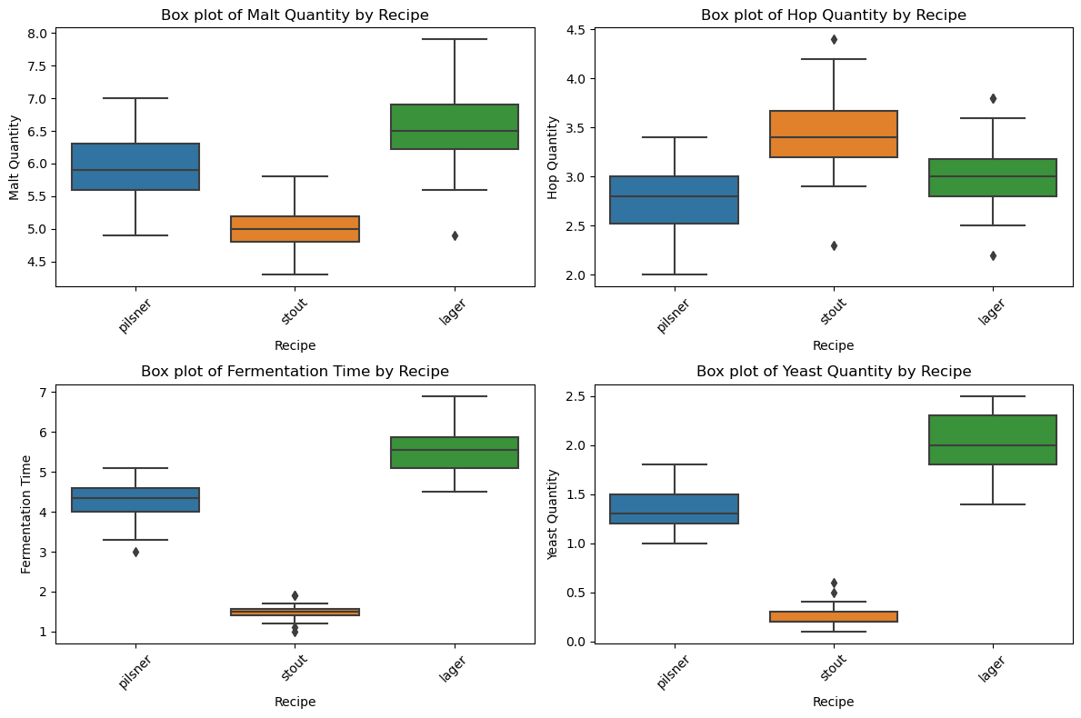
Category Analysis
One Lager recipes use less malt quantity compared to other Lager beer.
Some stout and lager recipes deviate from the norm by using either less or more hop quantity.
Fermentation time for stout can vary significantly among recipes, with some taking less time and others requiring more than average.
Two stout recipes stand out for their higher yeast quantity compared to the rest of the recipes analyzed.

Slide 6
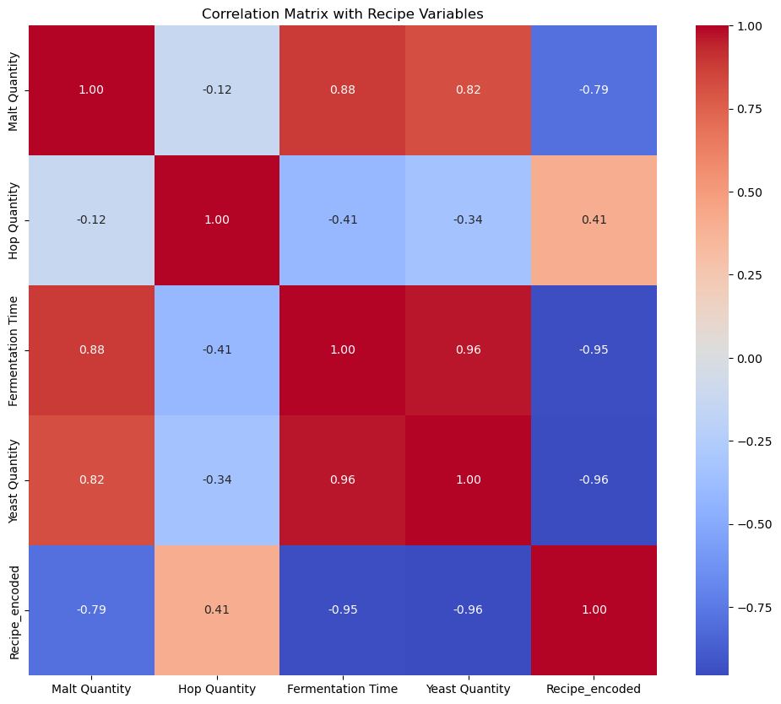
Correlation Matrix
Considering the impact of hop quantity, it is evident that it significantly contributes to our model.
Cross-checked these results using Pearson correlation coefficients found same results.

Slide 7
Logistic Regression Results
Logistic Regression was employed, yielding an accuracy of 96.67%.
Through grid_search, optimal hyperparameters were determined as
{'C': 1, 'penalty': 'l2', 'solver': 'saga’}.
Utilizing the L2 penalty to mitigate overfitting, the model achieved an impressive accuracy of 100%, indicating it accurately captured all values in the dataset.

Slide 8
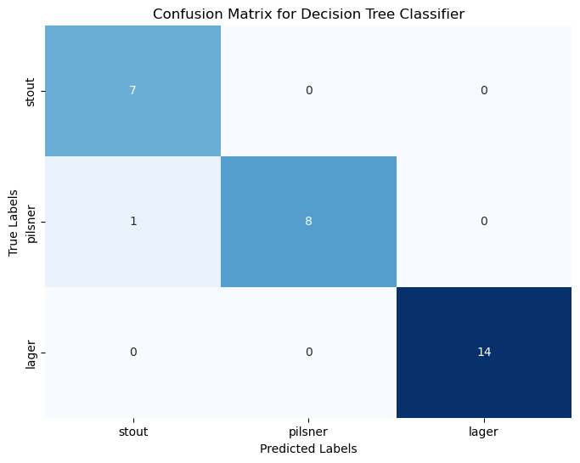
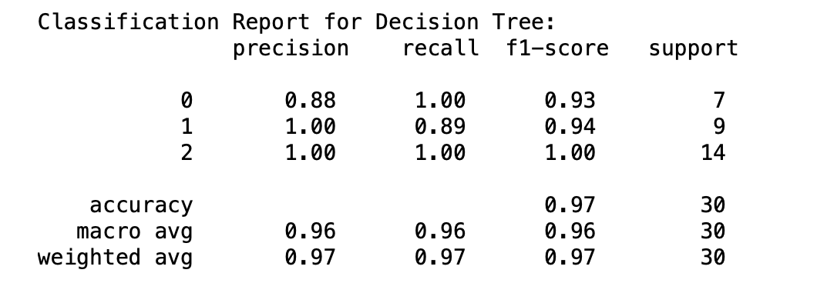
Decision Tree Classifier
The Decision Tree Classifier exhibited an accuracy of 96.67%.
A detailed classification report was generated to assess the model's performance across different metrics.
Nearly all beer recipes correctly identified, except for one misclassification where a Pilsner was erroneously classified as a Stout

Slide 9
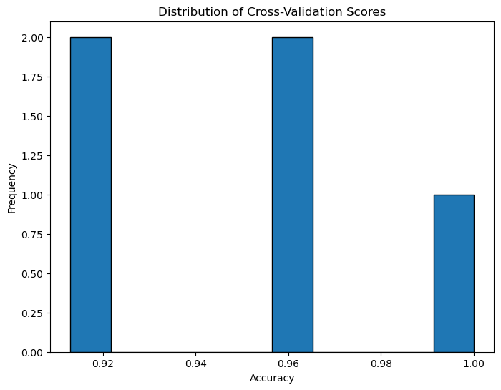
K-fold Cross Validation
Below are the cross-validation scores
0.95833333
0.91304348
0.91304348
0.95652174
1.0
Bar chart shows the visuals of cross validation

Slide 10
Conclusion
The dataset's relatively small size and simplicity were key factors contributing to our model's excellent classification performance.
Exploratory Data Analysis (EDA) revealed that Lager recipes typically involve a greater quantity of ingredients and fermentation time, potentially making them a preferred option. However, further analysis integrating sales data is necessary to understand how these recipes perform in the market.
To address potential overfitting, I employed data shuffling, utilized L2 penalty regularization, and implemented k-fold cross-validation techniques, ensuring the robustness and generalization capability of our model.

Slide 11
Cheers !

